Slide 1
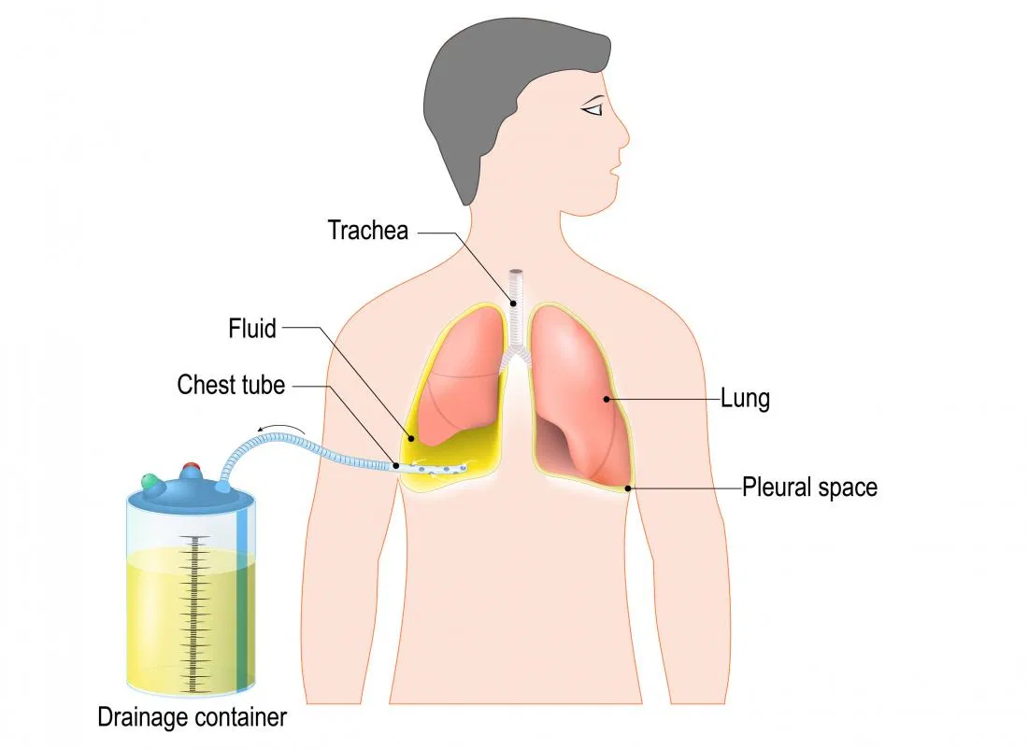
Adult Nursing(2nd Stage)
Chest tube
Lecture 5 (practice)
By
Assistant. Lecturer. Khadija Mohammed Jassim
Fundamentals of Nursing Department
College of Nursing
University of Basrah
University of Basrah –College of Nursing – Fundamentals of Nursing Department

Slide 2
Chest tube
A chest tube is a hallow plastic tube that is inserted into the chest cavity to remove or allow the drainage of fluid, blood or air from that portion of the chest cavity.
Drainage is marked on the collection chamber and documented every 8 hours.
University of Basrah –College of Nursing– Fundamentals of Nursing Department
2

Slide 3
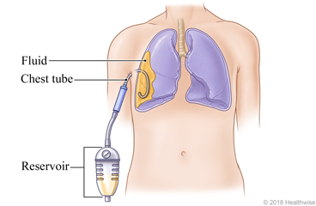
University of Basrah –College of Nursing– Fundamentals of Nursing Department
3

Slide 4
Indications
To permit drainage of air and fluid from the plural cavity.
To establish normal negative pressure in the pleural cavity for lung expansion.
To equalize pressure on both sides of the thoracic cavity.
To provide continuous suction to prevent tension pneumothorax.
University of Basrah –College of Nursing– Fundamentals of Nursing Department
4

Slide 5
Contraindications
Coagulopathy.
Pulmonary disease.
Trauma .
Loculated pleural effusion or empyema.
Skin infection over the chest tube insertion site.
University of Basrah –College of Nursing– Fundamentals of Nursing Department
5

Slide 6
Sites For Chest Tube Insertion
If removal of air from around a collapsed lung is the goal, the tube is inserted into the upper anterior chest, in the second to fourth intercostal space.
If removal of fluid is the goal, such as after an injury, the tube is inserted in the lower lateral chest, in the eighth or ninth intercostal space.
If a patient has both air and fluid to drain, two tubes are inserted and may be joined with a Y connector before connecting to the tubing that leads to a drainage system.
University of Basrah –College of Nursing– Fundamentals of Nursing Department
6

Slide 7
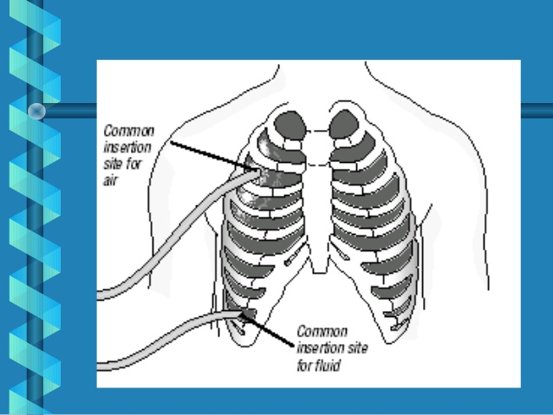
University of Basrah –College of Nursing– Fundamentals of Nursing Department
7

Slide 8
Size Of Chest Tube
Adult or teen male 28—32 Fr
Adult or teen female 28Fr
Child 18 Fr
Newborn 12—14 Fr
Trauma 36-40 Fr
Hemothorax 36-40 Fr
Empyema or chylothorax 32-36 Fr
Pneumothorax 26-32 Fr
University of Basrah –College of Nursing– Fundamentals of Nursing Department
8

Slide 9
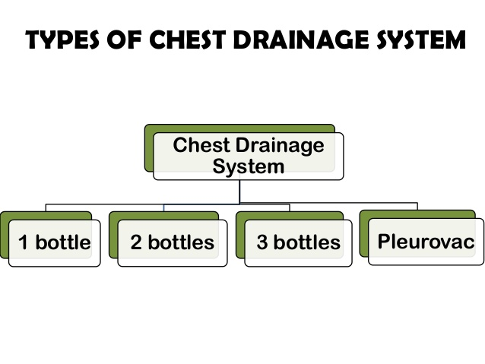
University of Basrah –College of Nursing– Fundamentals of Nursing Department
9

Slide 10
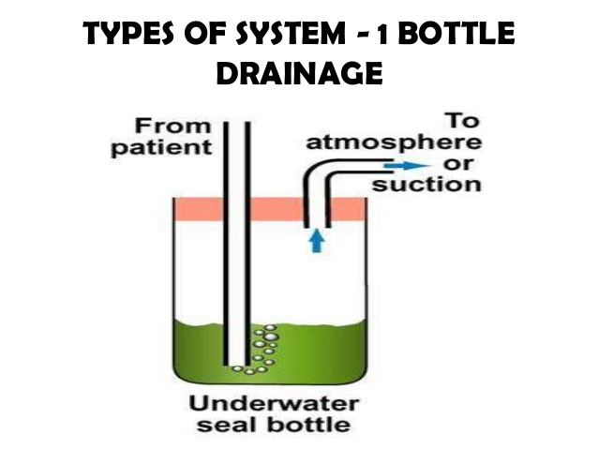
University of Basrah –College of Nursing– Fundamentals of Nursing Department
10

Slide 11
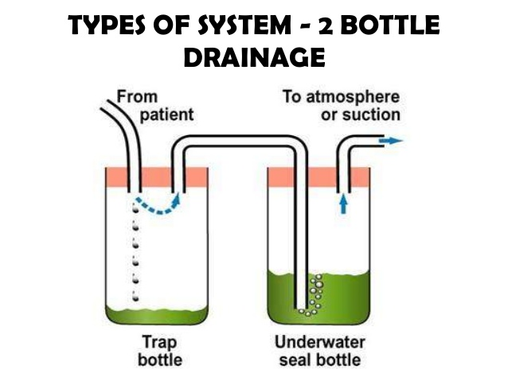
University of Basrah –College of Nursing– Fundamentals of Nursing Department
11

Slide 12
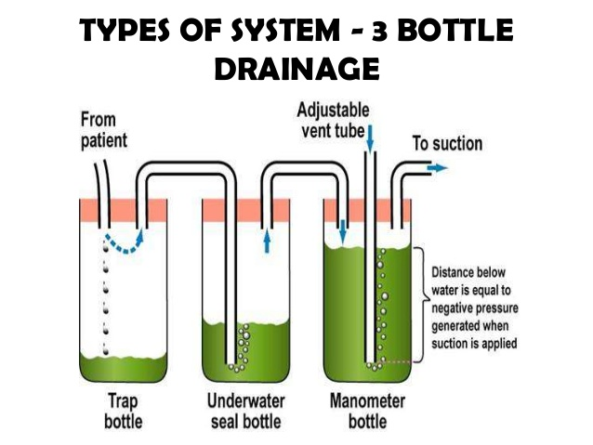
University of Basrah –College of Nursing– Fundamentals of Nursing Department
12

Slide 13
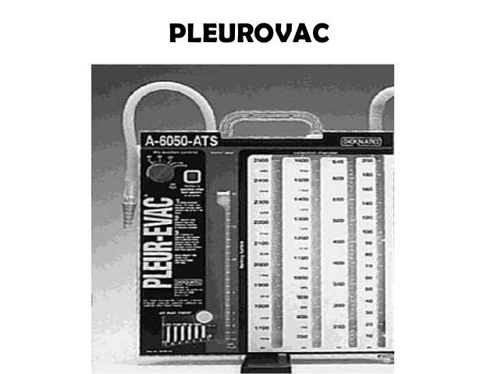
University of Basrah –College of Nursing– Fundamentals of Nursing Department
13

Slide 14
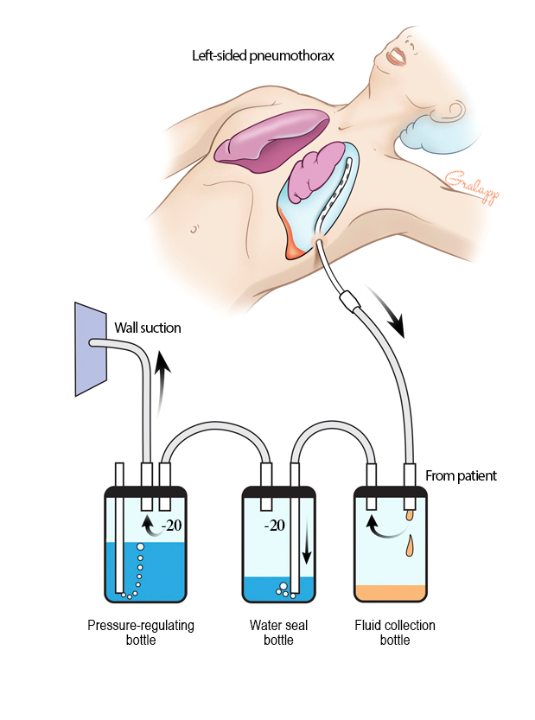
University of Basrah –College of Nursing– Fundamentals of Nursing Department
14

Slide 15
Equipment need for chest tube
Chest tube insertion tray
Tube (appropriate size).
Local anesthesia.
Antiseptic (iodine) .
Suturing supplies.
Sterile gloves and gown.
2-1000 cc bottles of sterile water or plastic bag.
Gauze pad
Section tubing.
Chest tube collection system.
Tape.
Syringe and needle( 21-25 gauge)
Scalpel and blade.
An instrument for blunt dissection if required (curved clamp)
Dressing .
University of Basrah –College of Nursing– Fundamentals of Nursing Department
15

Slide 16
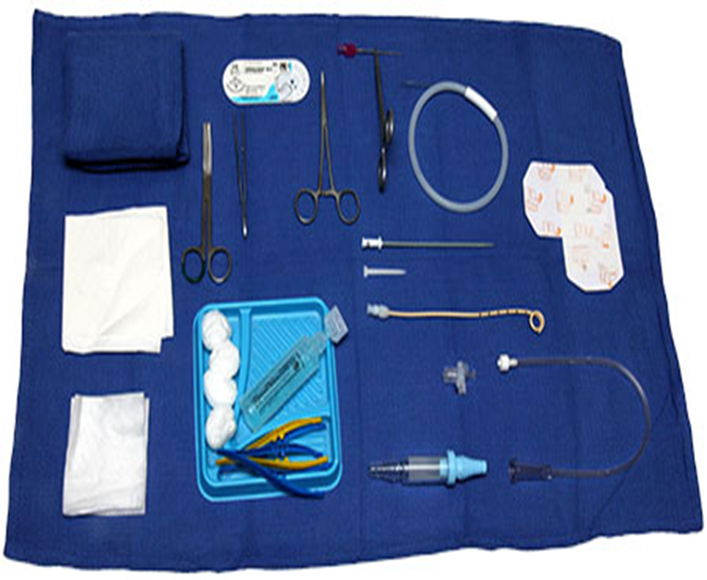
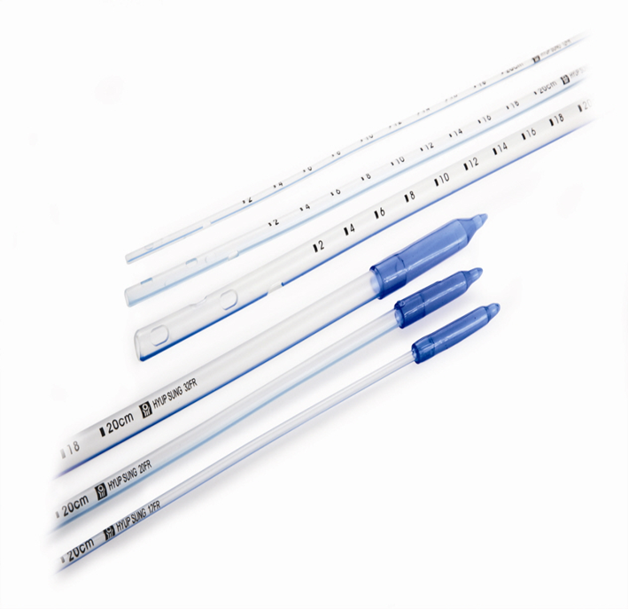
University of Basrah –College of Nursing– Fundamentals of Nursing Department
16

Slide 17
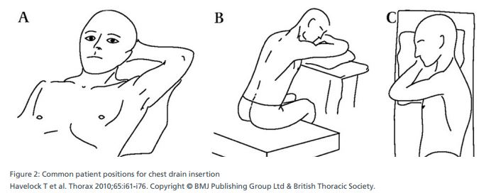
Preparation
The patient will need to be positioned according to where the chest tube will be placed.
Typically having the patients' arms over their head.
Pre-medicate the patient with sedation and pain medicine as per order.

Slide 18
Procedure of chest intubation
Local anesthesia, conform location.
Skin incision at selected area.
Dissect into pleural cavity thru a subcutaneous tunnel.
Locate pleural cavity.
Insert tube posteriorly and laterally.
Close incision wound, fixed the tube.
Connect tube to underwater seal bottle or with negative pressure suction.

Slide 19
Post procedure
Cardiovascular assessment may be performed every 4 hours .
Encourage patient to cough and deep breath.
Check insertion site every day and replace dressing .
Assess water levels in drainage unit each shift .
Report to physician immediately any change or complication with the chest tube.
Check all tubes connections and re-tape as needed.

Slide 20
7. Input and Output to be completed .
8. Monitor for air leaks , chest x-ray results, oxygen saturations and peak airway pressures.
9. Keep tubing coiled on bed , never allow tubing to dangle.
10. Ensure that bedside collection unit never goes above chest level.
University of Basrah –College of Nursing– Fundamentals of Nursing Department
20

Slide 21
Removal of Chest Tube
When the reason for the chest tube is resolved, the HCP removes it and places petroleum jelly gauze and a sterile occlusive dressing over the site.
Continue to watch for development of crepitus and monitor the patient’s respiratory status and dressing site.
University of Basrah –College of Nursing– Fundamentals of Nursing Department
21

Slide 22
Complications
Pain during placement: Chest tube insertion is usually very painful. help to manage pain by injecting an anesthetic through an IV or directly into the chest tube site.
Infection: As with any invasive procedure, there’s a risk of infection. The use of sterile tools during the procedure helps reduce this risk.
Bleeding: A very small amount of bleeding can occur if a blood vessel is damaged when the chest tube is inserted.
Poor tube placement: In some cases, the chest tube can be placed too far inside or not far enough inside the pleural space.
University of Basrah –College of Nursing– Fundamentals of Nursing Department
22

Slide 23
University of Basrah –College of Nursing– Fundamentals of Nursing Department
23

Slide 24
University of Basrah –College of Nursing– Fundamentals of Nursing Department
24

